Slide 1

STAY FIT
DECIDE.COMMIT.SUCEED.

Slide 2
Introduction
STAY FIT is a web application for analyzing and logging strength training and body building data. It aims to present workout data in a way that highlights and encourages progressive overload and long-term commitment.
The workouts are broken into set of exercises and each set is associated with exactly one exercise.

Slide 3
Features
Simple workout data entry supporting reps, sets, weight, duration, warmup and actual workouts
Muscular visualizations(just like animations)
Intensity and volume calculations
Import
Export
Track and visualize our workout data
Exercise search
Supports multiple workouts per day
Proper time zone support (important for people who travel)
Lots of charts

Slide 4
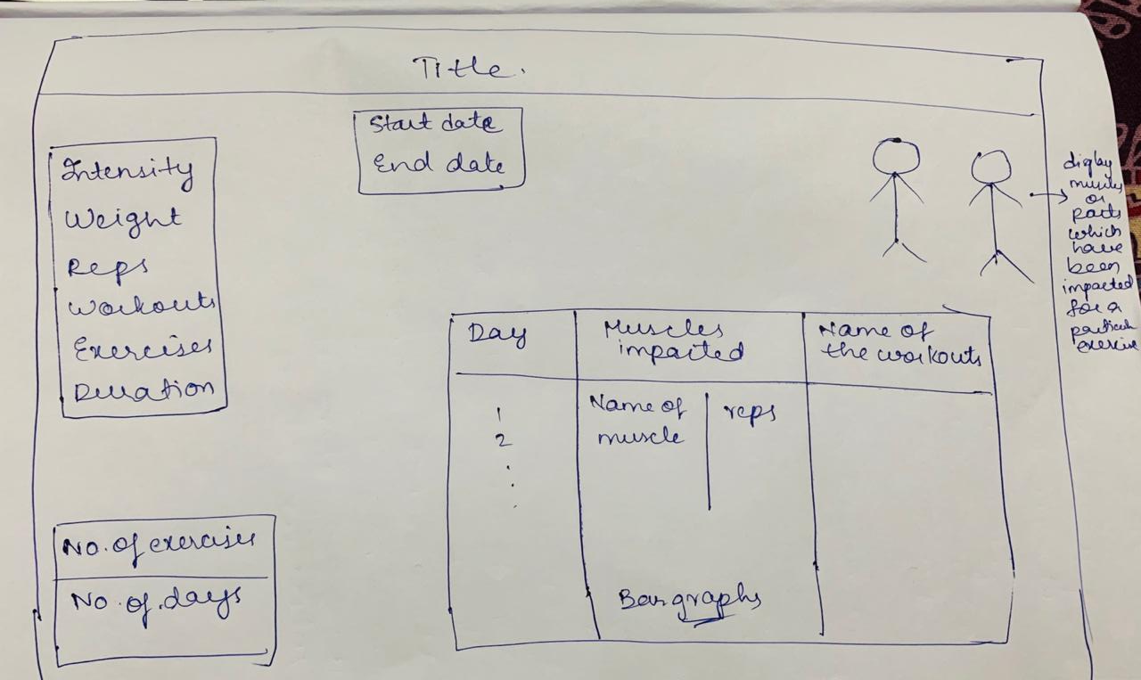

Slide 5
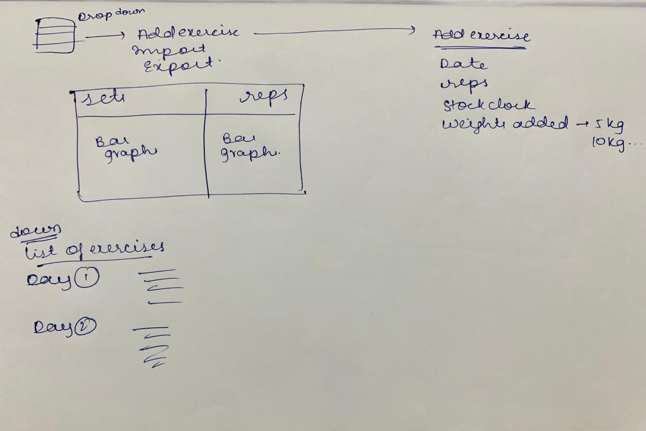

Slide 6
Software Requirements
FRONTEND: HTML,CSS,JS.
BACKEND: PHP, MySql, IndexedDB.

